Slide 1
Webinar Agenda
2:00 PM EDT - Kick-off and introductions – Ken will introduce the Webinar, briefly introduce SchoolSims and Simulation, and then introduce Dave Versteeg, who will introduce himself and then all of you.
2:10 PM EDT - Intro to the Challenge of developing Equity Centered Leaders and Principal Pipeline in general and the potential power of Simulations – Dave will briefly reflect on the challenge facing our schools from his perspective as a Superintendent and then introduce all of you.
2:15 PM EDT - Each Panelist will share their work (up to 2-3 minutes each; Dave has promised to be a tough timekeeper!) – I will be sharing a link to the Google Doc that has a page for each of you with a couple of Prompts that you can respond to around your work and your use of the Sims so that we have some consistency. Feel free to let me know if you would like to address additional elements.
2:30 PM EDT - Facilitated Discussion among Panelists – I am interested in questions that you think would be of value to discuss amongst the Panel, so feel free to suggest them in this thread. We have put together a few ideas that we will use as a starting point and evolve that list based on your input. Dave will facilitate a discussion among the panelists. It need not be everyone taking a turn, as the intent is to open up to a cross-panelist conversation.
2:50 PM EDT - Open up to Q&A from attendees.
3:00 PM EDT - Ken will wrap up.

Slide 2



Slide 3


Slide 4
Discussion Facilitation Questions/Prompts:
Now that we know a bit about your experience with simulations, I would love to surface a bit more about what you are learning during the process, from the use of simulations in developing leaders to the use of the sims themselves – Do you have any thoughts to share?
Which simulation is best framed around equity, even though it might not be equity titled? Does it ensure that students are treated fairly in every culture and context?
Have you used the sims in an interview situation, hiring situations, or tabletop discussions, to drive the same debate differently?
How does the location of your schools, urban, suburban, metro, or rural, address the contextual issues of equity?

Slide 5


Dave Versteeg
Superintendent Mason City Community School District
Mason City, Iowa

Slide 6
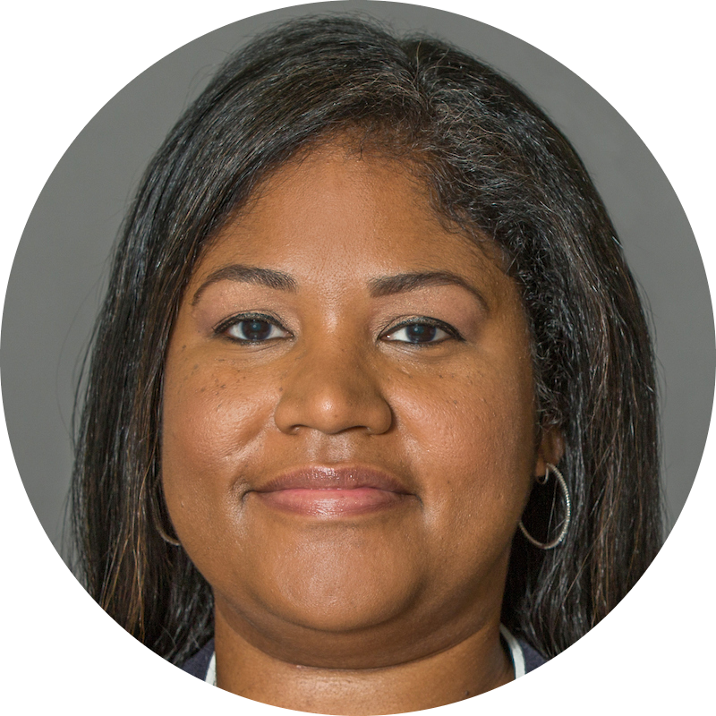

Courtney Wall
Director | Principal Pipeline Initiatives CMS Department of Ed. Leadership
Charlotte, NC
How are simulations used in your program? Currently, we use simulations to prepare our most effective aspiring leaders to step into the principal role. Paired with professional learning aligned to the district’s Equity-Centered Leadership Framework, the simulations provide an opportunity to apply learning to real-world situations in a risk-free environment. In small groups, participants often draw on their strategic decision making and problem solving skills to navigate the challenge. The immediate feedback allows participants to reflect on and evaluate the effectiveness of their leadership actions. There is also knowledge and insight to be gained from facilitating a simulation.
How do simulations increase principals' ability and knowledge to lead schools as equity-centered instructional leaders who ensure that every student has a positive learning experience and achieves high levels of achievement? Pairing simulations with professional learning aligned to the district’s Equity-Centered Leadership Framework supports leaders in evaluating situations through an equity lens. When applying their learning to the simulation, leaders are able to confront and disrupt inequities, establish a culture of continuous improvement and high quality learning for all students, and create a results oriented environment.
What do the sims allow you to do differently than other development efforts from an equity centered perspective? From a strategic perspective, simulations have allowed our leaders to explore and apply principles of equity centered leadership to familiar, real life scenarios while receiving immediate feedback on the impact of their decisions without an effect on their schools. No other professional learning efforts allow participants to “practice” and experience the possible outcomes of their leadership moves.

Slide 7
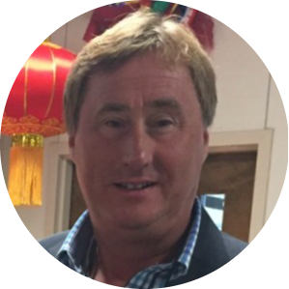

Dan Ray, Ed.S.
Leadership Development Specialist Rockdale County Public Schools
Conyers, GA
How are simulations used in your program? We use the simulations in three ways. First of all, we send out a simulation to everyone that is in the REAL Academy regardless of their cohort that they are in one week prior to our monthly seminar. The simulation either ties to the upcoming seminar topics or it ties to a current event that is occuring in the district. We will then discuss their responses and reflections as an entire group (aspiring APs & Coordinators, Induction level APs, aspiring principals & directors and Induction Level APs) during our “Huddle Time” at the beginning of class. We also make the simulations available upon request to any individual that applied to the academy that did not qualify in order to assist them in their development in the hopes that they will reapply the following year with some additional leadership experiences under their belt. A third way that they have been used was during COVID when we had virtual Principals’ Meetings. The Assistant Superintendents over the 3 levels used them at the beginning of the meetings as a “thought provoker.”
How do simulations increase principals' ability and knowledge to lead schools as equity-centered instructional leaders who ensure that every student has a positive learning experience and achieves high levels of achievement? Our desire is to assist the school administrators in “seeing the bigger picture” and having a “semi-experience” before they have to experience the scenario/simulation “in real life” with the hopes that the discussions that occur with their colleagues will increase their awareness, reflective thinking, sensitivity and confidence in dealing with whatever “comes their way” in their daily leadership journey.
What do the sims allow you to do differently than other development efforts from an equity centered perspective? Based on the feedback we have received from the first 4 cohorts (approximately 100 participants) of the REAL Academy, the members have stated that this “piece” of what we do is invaluable and has provided the insights that they had not gained in any other type of class, experience, conference, etc. They have made it clear that they believe this has made them more effective for all students in the area of academic achievement and student success.

Slide 8


Malaika Bryant
Director II, Educator Development & Data Support
Kern County Superintendent of Schools
Bakersfield, CA
How are simulations used in your program? We use the simulations to provide an opportunity for administrators to practice decision making skills in a low-risk environment, and debrief with others their thinking processes. We provide multiple pathways to access these opportunities. We select a simulation to facilitate with a large group during each of our program networking sessions, coach/candidate pairs may access any of the simulations that align with a particular goal or standard focus or that addresses a specific concern that arises, we have provided a leadership series that is open to any interested administrator, we have also partnered with with small local districts to create a new leadership program utilizing the simulations to support new leaders to develop capacity together in these areas.
How do simulations increase principals' ability and knowledge to lead schools as equity-centered instructional leaders who ensure that every student has a positive learning experience and achieves high levels of achievement? The simulations provide the administrator the opportunity to practice skills, slow down and reflect, which is critical to the application of new learning to future practice. The simulations provide the opportunity to go through an experience while also stopping to think (rare in real life), and discuss the implications of decisions made. This all help to build the capacity to apply this learning to new situations that arise in a proactive manner.
What do the sims allow you to do differently than other development efforts from an equity centered perspective? Experience and apply learning in a very real way- promote discussions that involve everyone actively de to the shared experience. They provide the opportunity to surface hidden thinking.

Slide 9


Ron Cabrera, Ph.D.
Former Superintendent Director 4 Corners ALAS Leadership Academy University of Colorado Denver Adjunct Professor, School of Education and Human Development
Boulder, CO
How are simulations used in your program? Because we are developing system-thinking leadership we try use the simulations in 2 distinct approaches: 1) to what extent will decision for the problem at hand impact the school system–is that your intent or will you have to mitigate the system response; 2) From a strategic perspective, what might other decisions that have to be considered to resolve the problem or create a solution at the district level–who might be other players in the decision-making process?
How do simulations increase principals' ability and knowledge to lead schools as equity-centered instructional leaders who ensure that every student has a positive learning experience and achieves high levels of achievement? Because we are targeting systems and senior leadership decision-making, we take the problems that are school-based and try to elevate the problems into district/system problems or use the school-based problem as a way to establish a precedent that might affect the whole system.
What do the sims allow you to do differently than other development efforts from an equity centered perspective? We love the fact there is an element of “reality” and action associated with the problems. Participants do connect with simulation characters and try to make decisions in a manner as if the individuals were “live.” These simulations and approach is superior to the case-study approach.

Slide 10
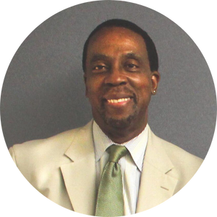

Donald O. Leake, Ph.D.
Coordinator, Educational Leadership Programs Department of Educational Administration and Secondary Education The College of New Jersey
Ewing, NJ
How are simulations used in your program? Sims in our leadership preparation program are used in two ways: 1. To facilitate discussion on sensitive issues - to break issues in its constituent parts and to study the relationship of the parts to the whole. 2. To humanize concepts – to adopt the point of view of the protagonist. That is, to make his/her dilemma – your dilemma.
How do simulations increase principals' ability and knowledge to lead schools as equity-centered instructional leaders who ensure that every student has a positive learning experience and achieves high levels of achievement? All of us are prone to professional blind spots – particularly as related to equity issues. The sims are a safe way to explore “undiscussables” such as implicit bias and microaggressions.
What do the sims allow you to do differently than other development efforts from an equity centered perspective? Sims are premised on the notion of “multiple concurrent realities” and when appropriately vetted –the Sims allow us to learn from our colleagues' lived experiences which may differ from our own.

Slide 11

Ken Spero
Chief Executive Officer
kspero@schoolsims.com

Slide 12
Panelist Contact Information:
Dave Versteeg Email: daveversteeg1@gmail.com
Courtney Wall Email: Courtneyg.wall@cms.k12.nc.us
Dan Ray Email: dray2@rockdale.k12.ga.us
Malaika Bryant Email: mbryant@kern.org
Ron Cabrera Email: Ron.G.cabrera@gmail.com
Donald Leake Email: leake@tcnj.edu

Slide 13
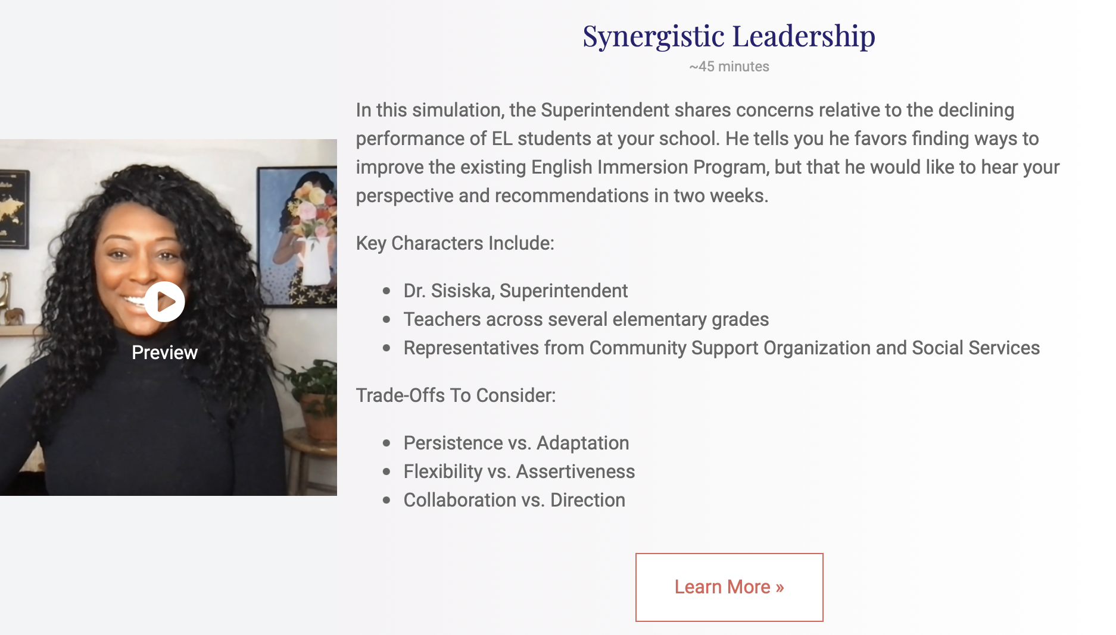
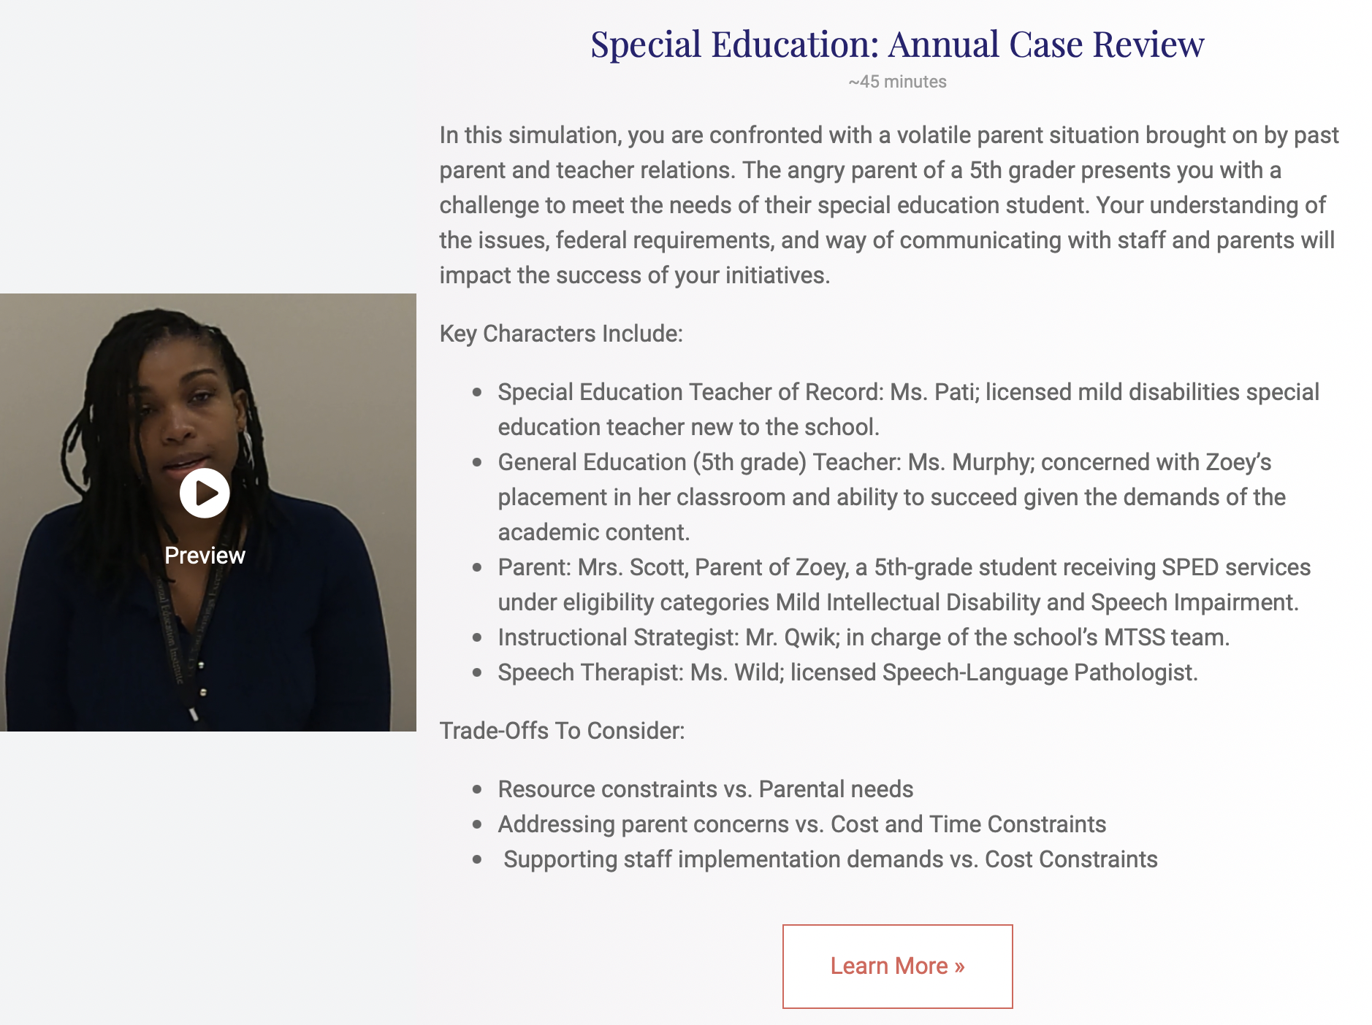
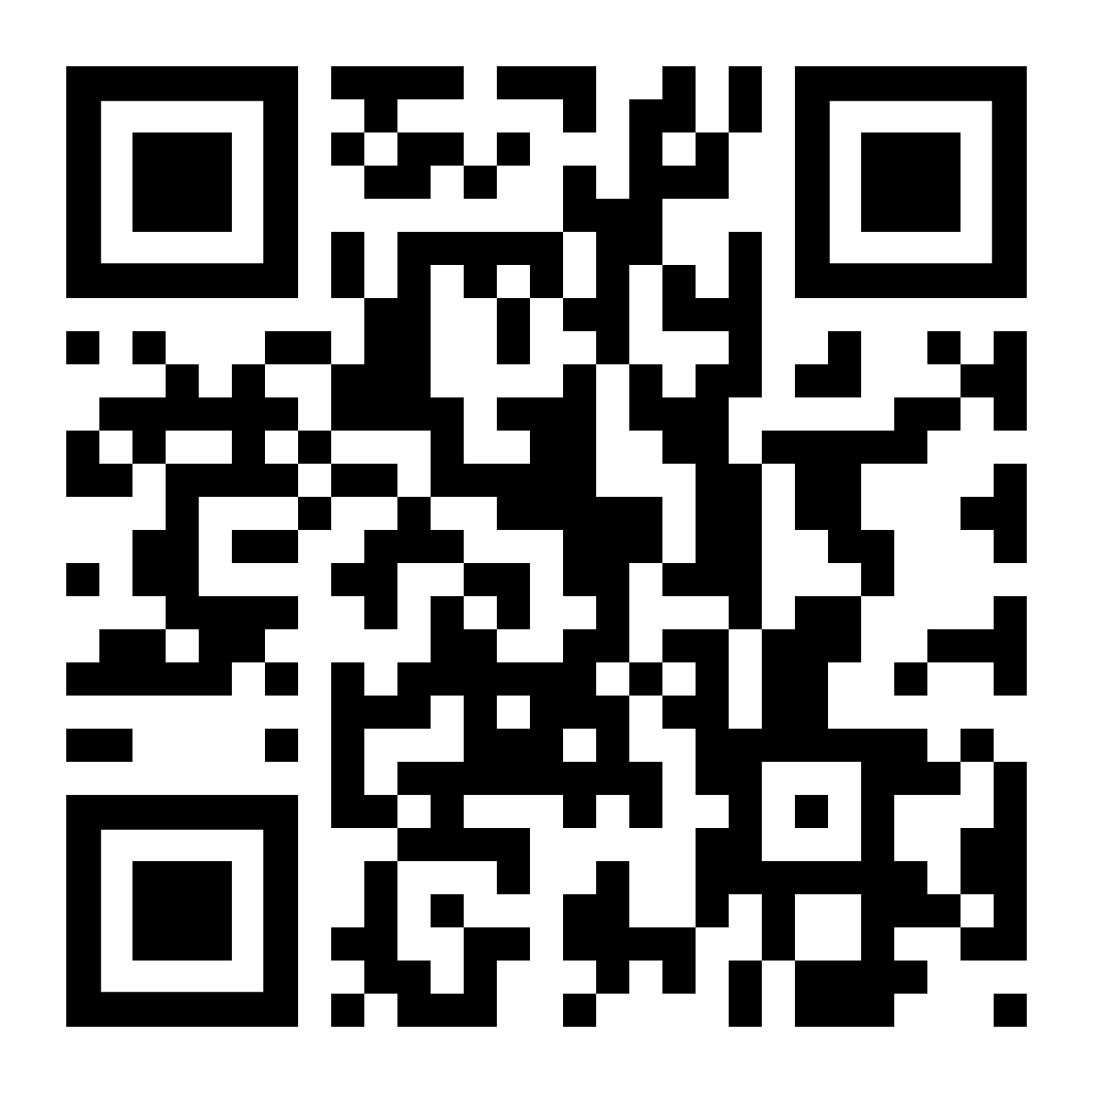
Two New Simulations Added to the SchoolSims Library!

Slide 14

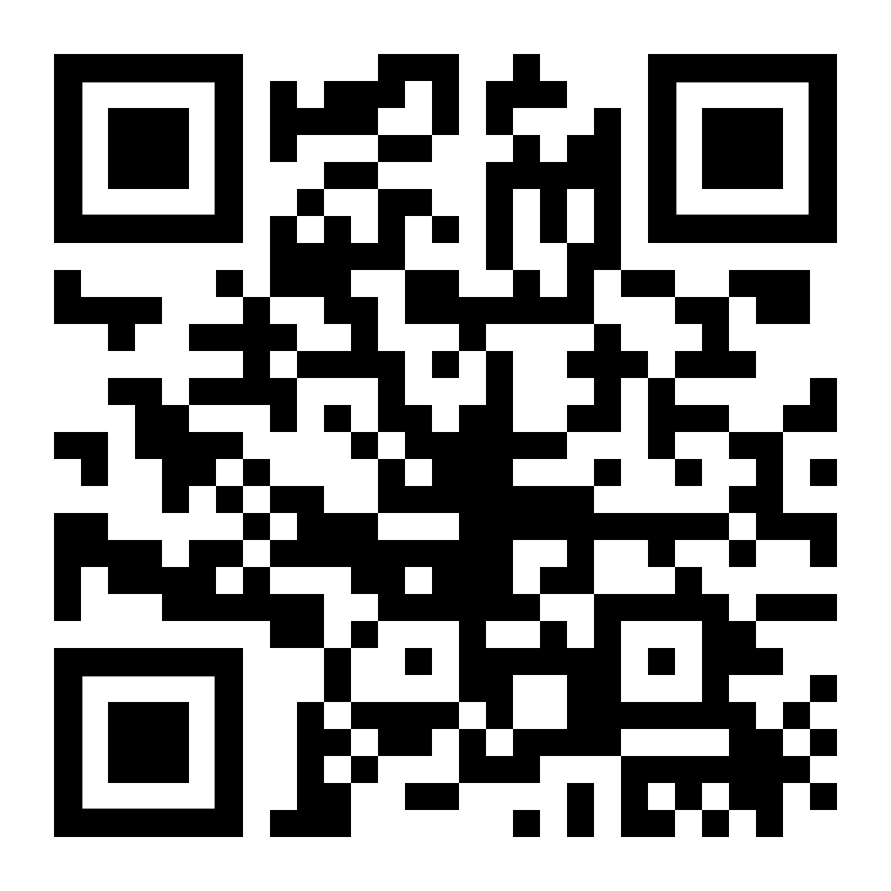

Slide 15


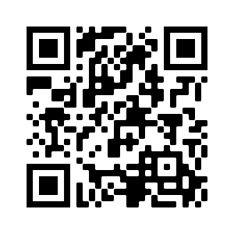
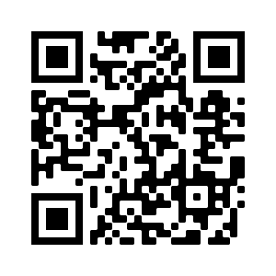

SchoolSimsPD
SchoolSims

