Slide 1



Slide 2
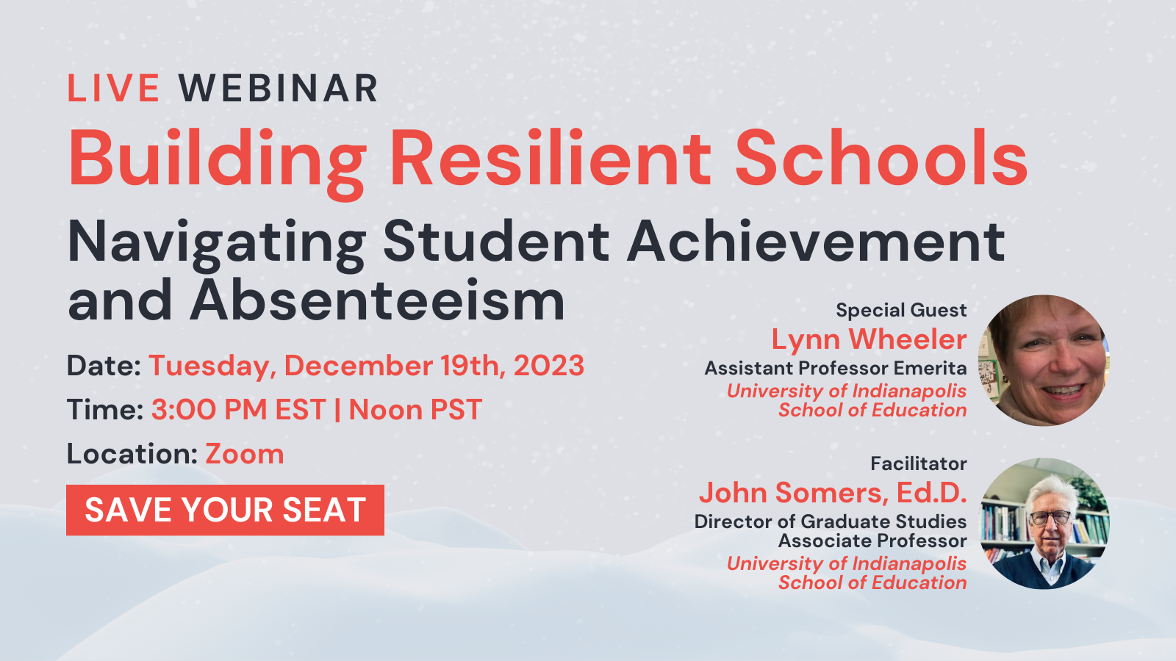

Slide 3
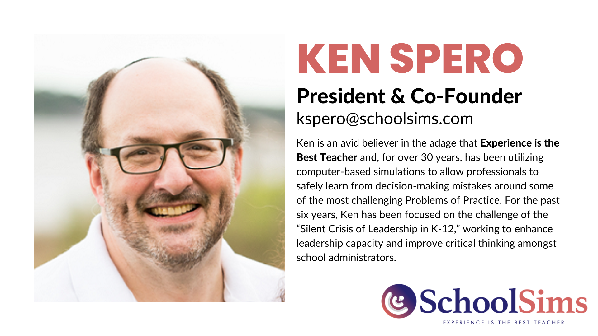

Slide 4
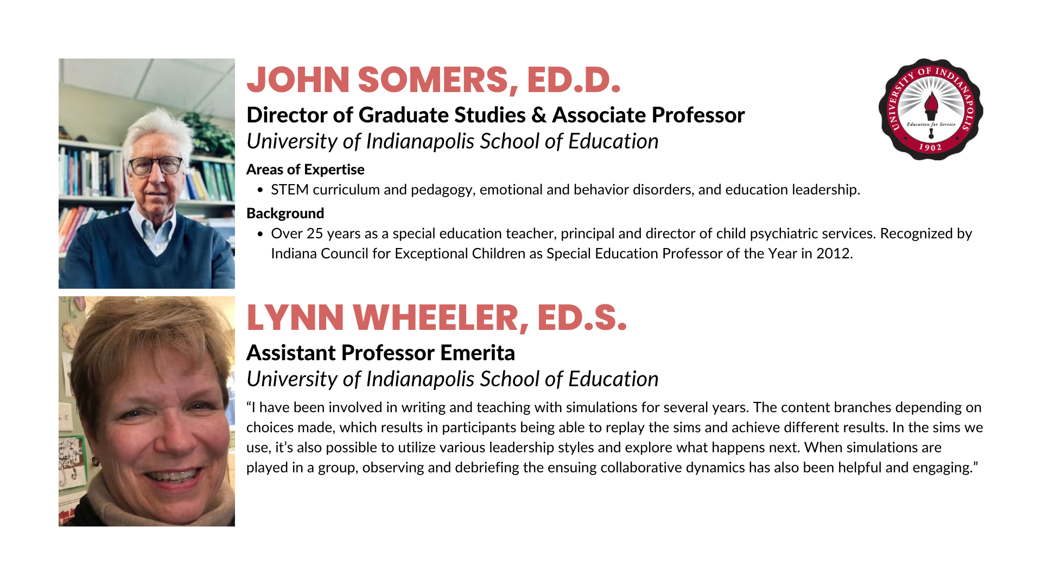

Slide 5
PEDAGOGY AND SIMULATION -
IN PREPARING TEACHERS AND ADMINS
Pedagogy - the art, science, or profession of teaching (M-W)
Commonly understood as the approach to teaching, is the theory and practice of learning, and how this process influences, and is influenced by, the social, political and psychological development of learners - Wikipedia

Slide 6
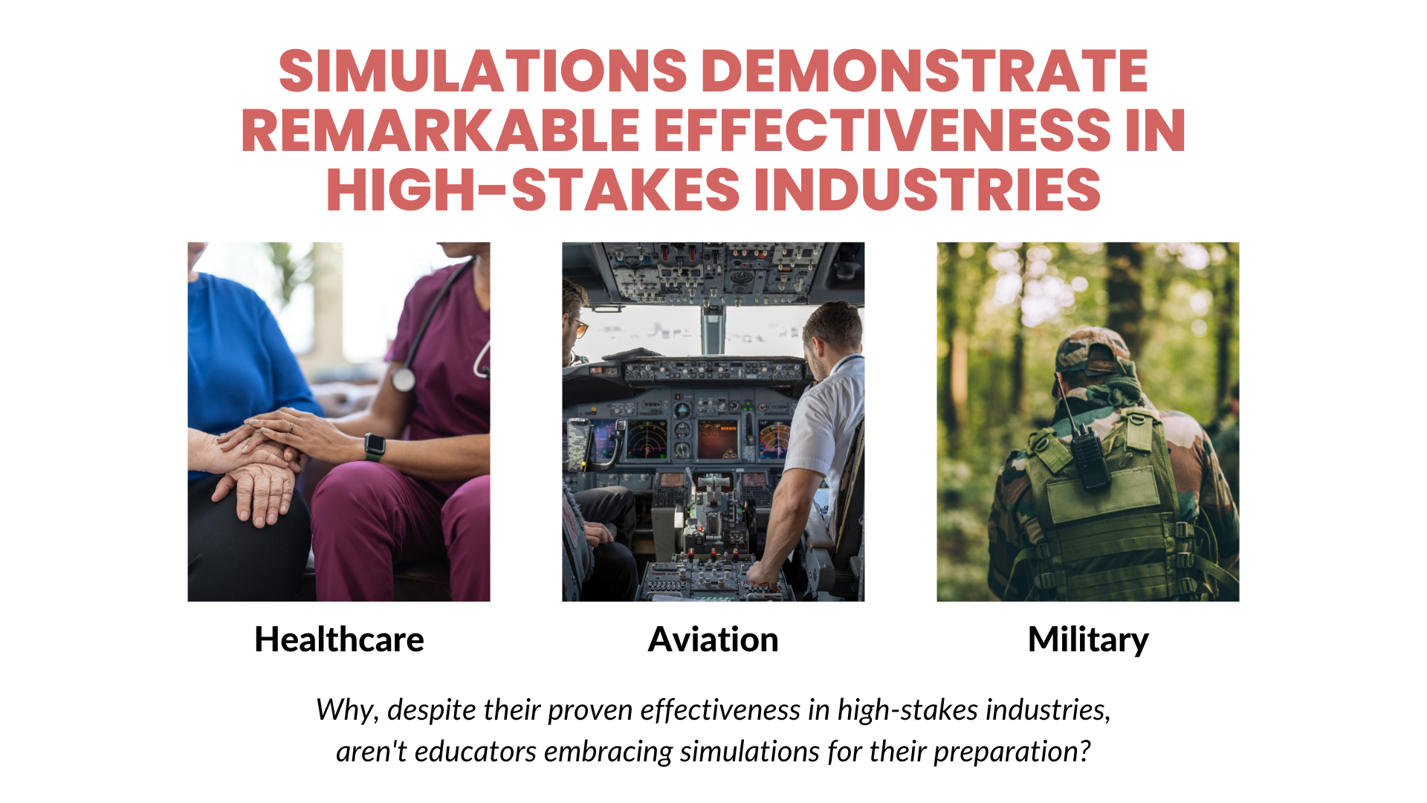

Slide 7
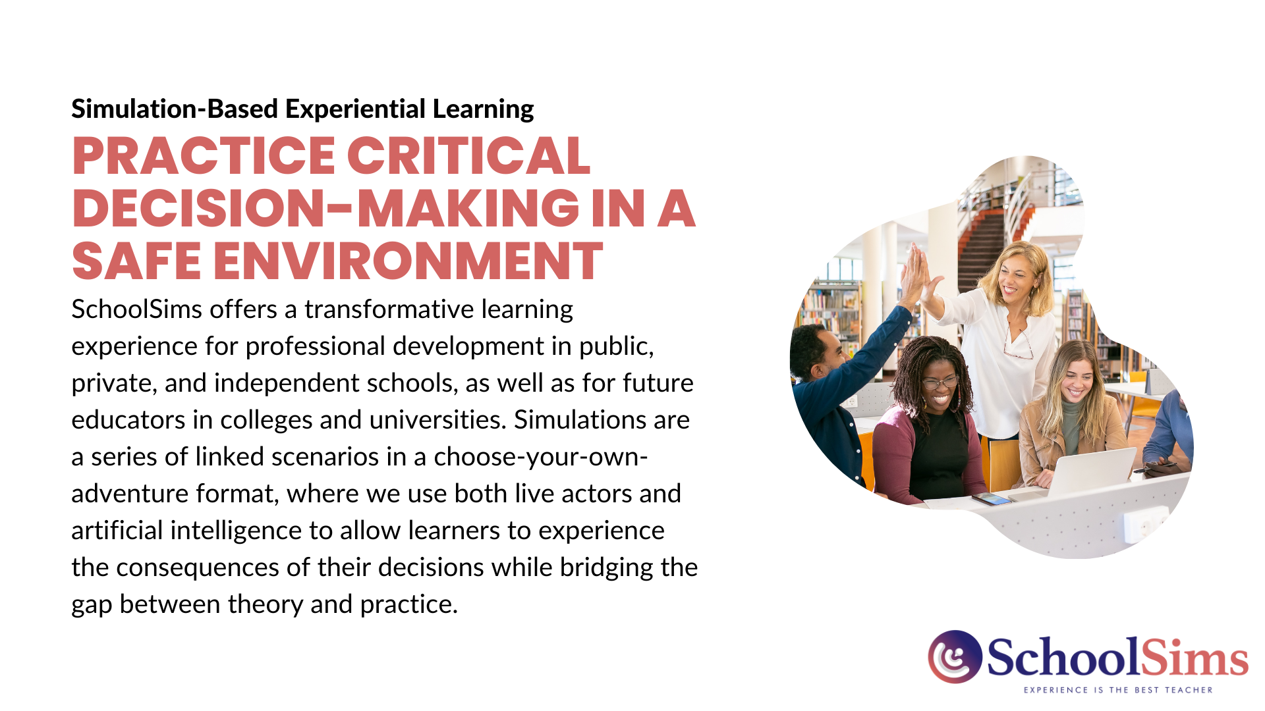

Slide 8
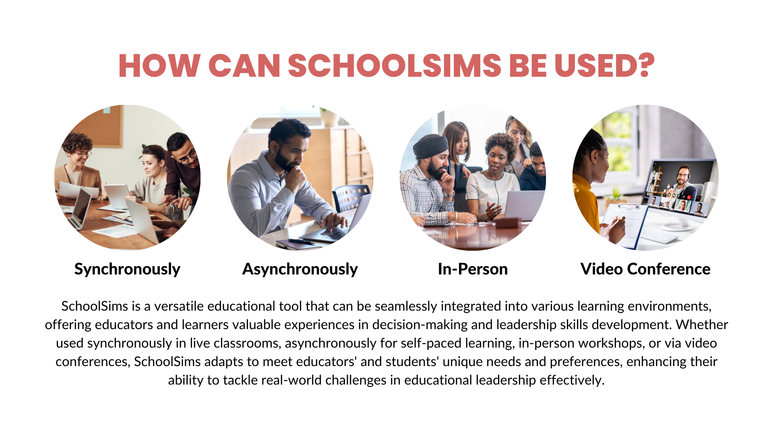

Slide 9
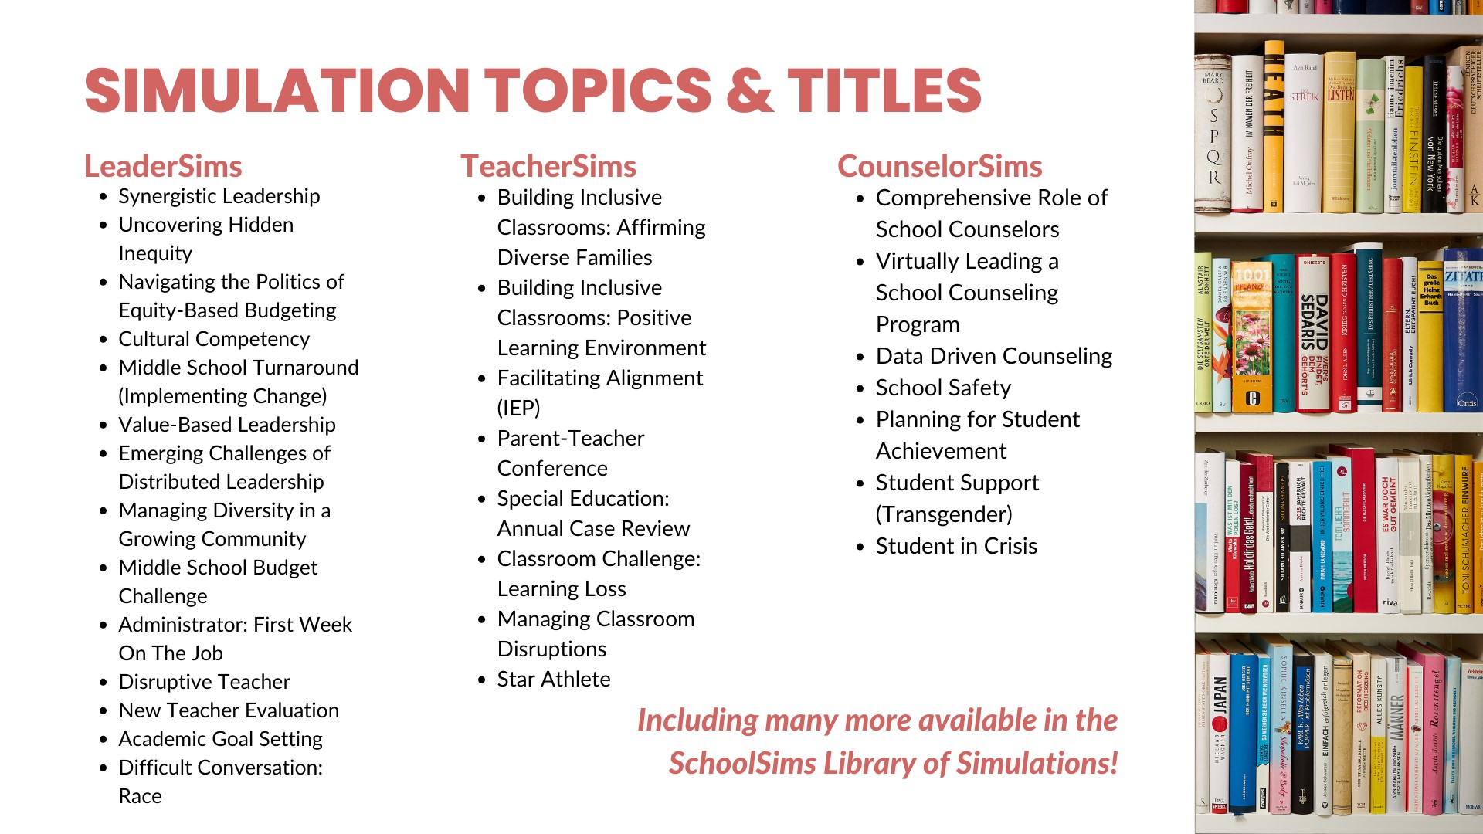
Notes:
Intro Slide
What States we are in
Higher Education
Highlight Ken Spero
2 Slides
Range of the libraries
Ed Leadership Programs
35 Sims
Highlight a few titles
LeaderSims, TeacherSims
1 slide where we are and 1 slide on the simulations

Slide 10
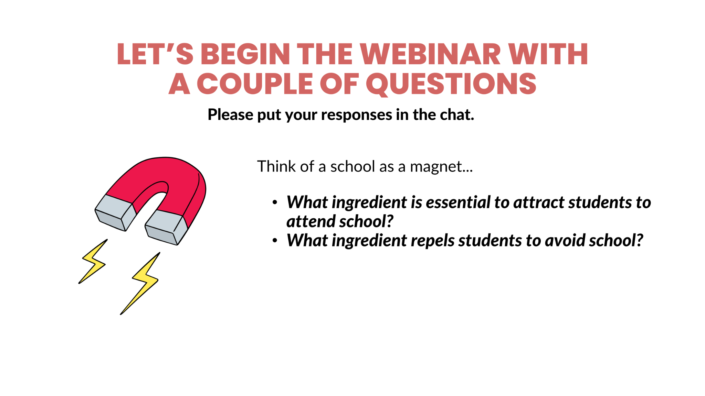

Slide 11
FRAMING THE ISSUE
A National Perspective
  The most recent federal data show that in the 2020-21 school year, at least 14.7 million students nationwide were chronically absent.
  Chronic absenteeism has almost doubled from the more than 8 million students, pre-Covid-19, who were missing so many days of school that they were academically at risk.
  How school districts are tackling chronic absenteeism, which has soared since the COVID-19 pandemic. (CBS NEWS)
(Attendance Works: https://www.attendanceworks.org/)

Slide 12
FRAMING THE ISSUE
A State Perspective: Indiana
  According to Indiana education officials, poor attendance is hurting academics.
  If all the Indiana students who missed school the most showed up on one day, they would fill around 3,000 buses.
  Citing the greater absenteeism rates for Black and Hispanic students, as well as those learning English or living in poverty, state board members sought to draw a link between absenteeism and lower test scores for those groups.
    “It could absolutely be a root cause,” said Secretary of Education Katie Jenner.
(Chalkbeat, October 2023)

Slide 13
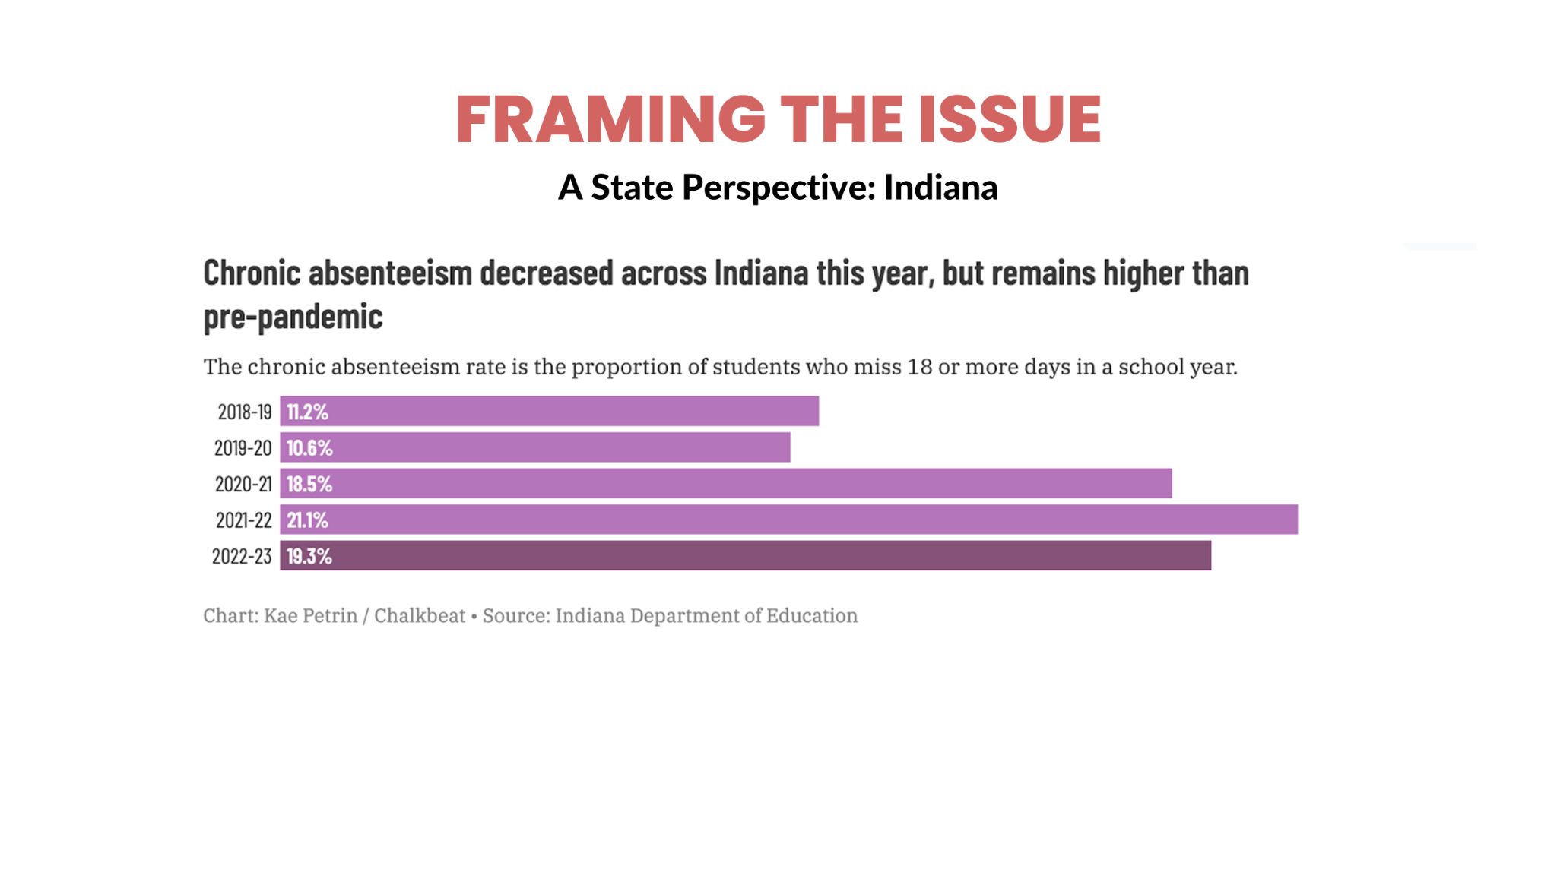

Slide 14
FRAMING THE ISSUE
A State Perspective: Indiana
  Absenteeism rates are highest in kindergarten and high school.
  Nearly one-third of all Black students were considered chronically absent in 2022-23, compared with 19% in 2018-19. The rate for Hispanic students surged to 24% in 2022-23 from around 13% in 2018-19.
  The rate for Asian students doubled in that time frame, from 6% to 12%. For white students, it rose to 16% from 9%.
  Absenteeism for English learners — whose academic performance has continued to decline even as other groups’ performance has stabilized — has also doubled since 2018-19.
By Aleksandra Appleton | October 4, 2023, 4:18pm EDT

Slide 15
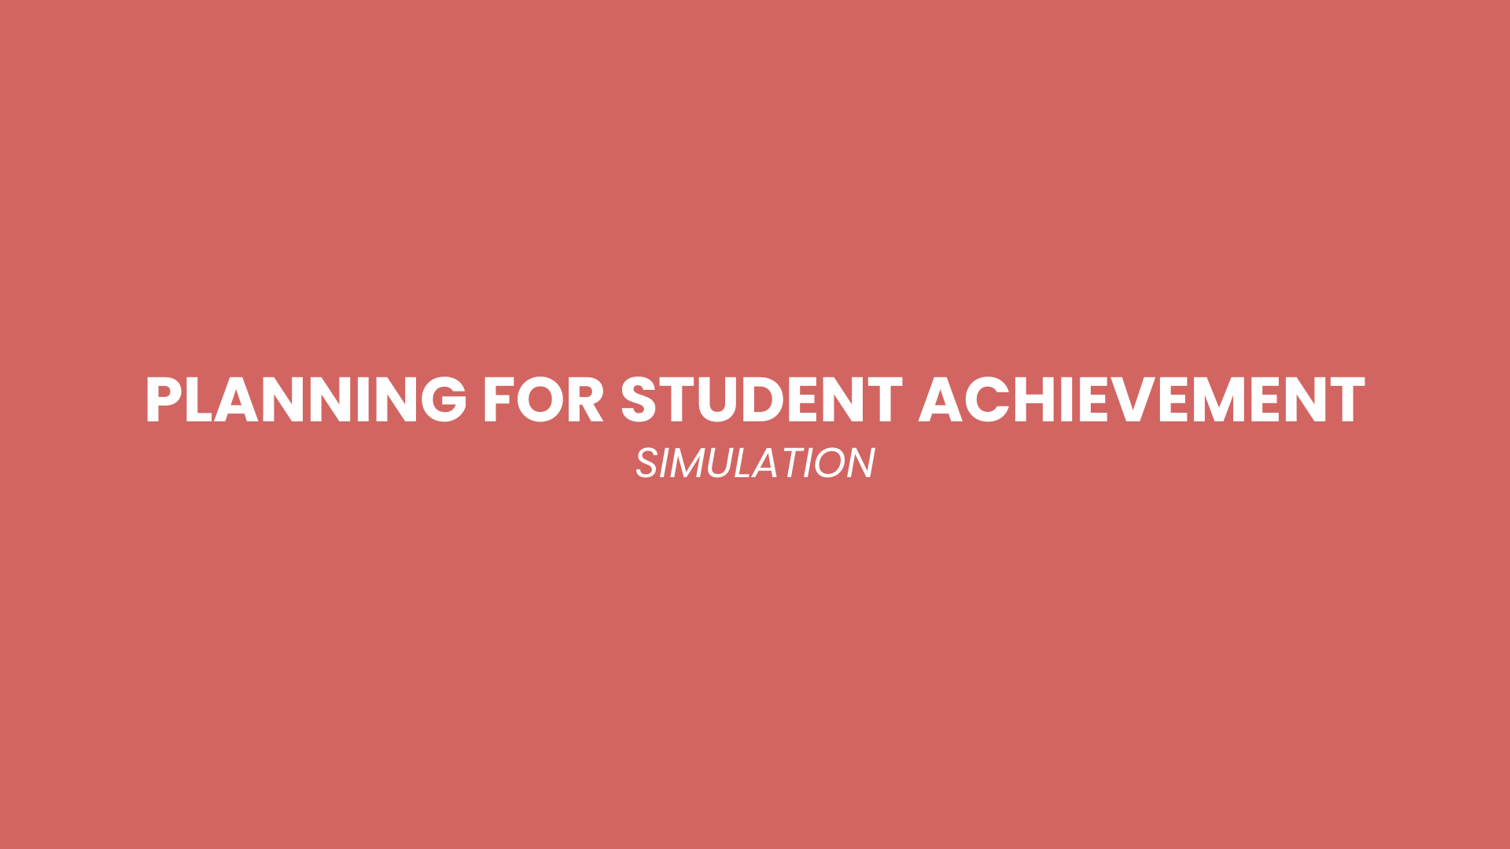
Notes:
Intro Slide
What States we are in
Higher Education
Highlight Ken Spero
2 Slides
Range of the libraries
Ed Leadership Programs
35 Sims
Highlight a few titles
LeaderSims, TeacherSims
1 slide where we are and 1 slide on the simulations

Slide 16
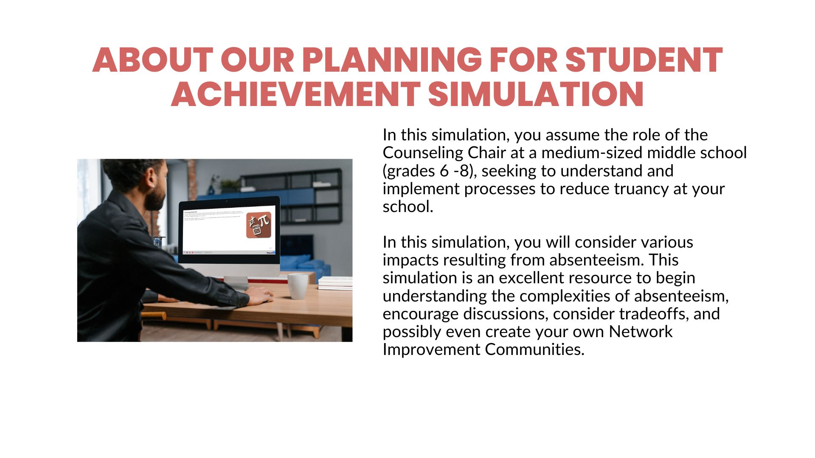
In this simulation you assume the role of the Counseling Chair at a medium sized middle school (grades 6 -8), seeking to understand and implement processes to reduce truancy at your school.
In this simulation you will consider a variety of impacts resulting from absenteeism. This simulation is an excellent resource to begin understanding the complexities of absenteeism, encourage discussions, consider tradeoffs and possibly even create your own Network Improvement Communities.

Slide 17

Notes:
Thank you for attending! If you would like to learn more about the pricing of SchoolSims, please email jjaramillo@schoolsims.com or click here: https://content.schoolsims.com/request-pricing.
We look forward to connecting with you soon!

Slide 18
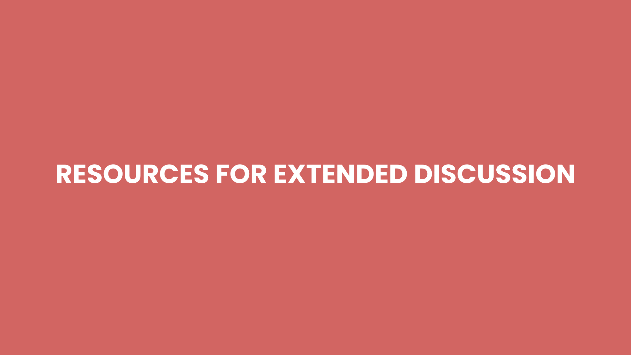

Slide 19
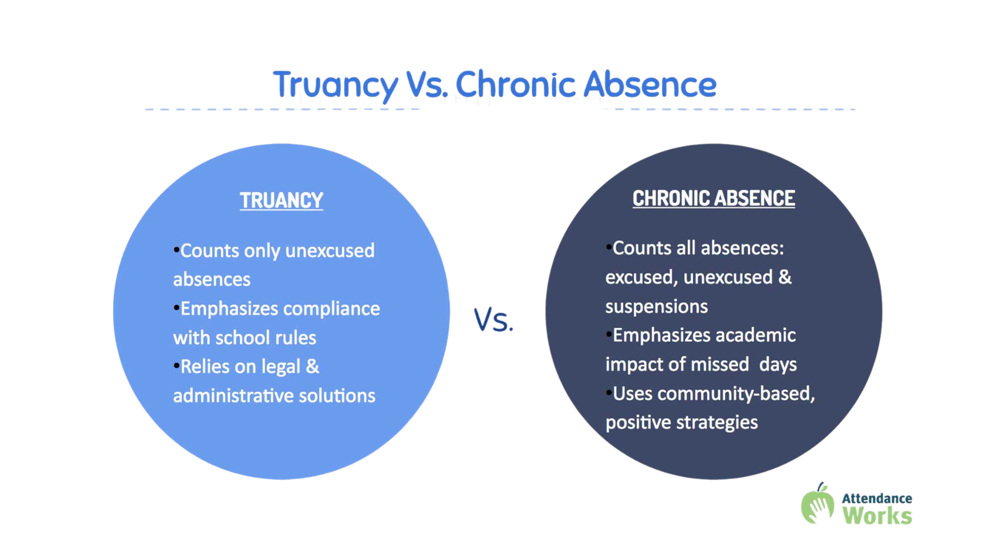

Slide 20
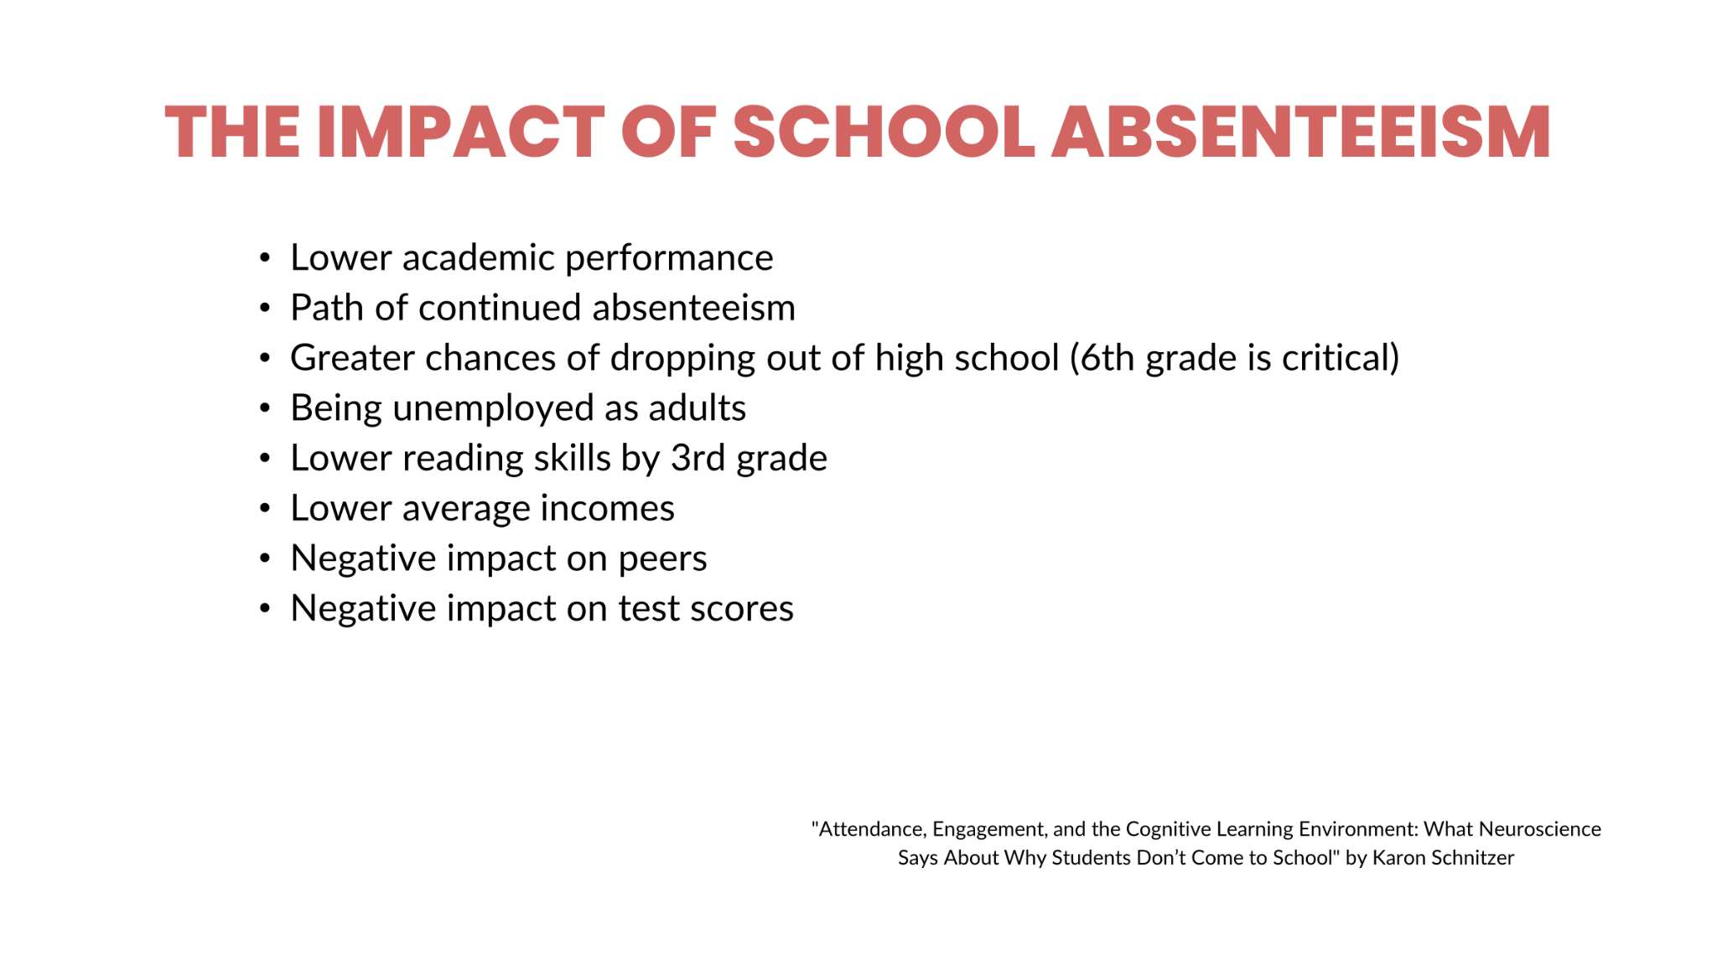

Slide 21
CLASSROOM AND PEER EFFECTS
Research Design
  This study examined whether a student was more likely to be chronically absent in the spring semester of the school year if they had a chronically absent classmate in the fall.
Findings
  We found that students were more likely to be chronically absent in the spring when their classmates were absent in the fall. This finding was consistent across model specifications.
Conclusions
  This finding supports previous research, highlights the value of promoting fall attendance, and aligns with current national, fall-based attendance-boosting policies and programs. When taken together with the idea that absences affect not only the absent child, but also raise the chance of other students being absent, it becomes even more crucial for administrators and policymakers to make informed decisions to address chronic absenteeism.
Gottfried, M. A., Kirksey, J. J., & Ozuna, C. S. (2020). Exploring the Links Between Student and Classmate Chronic Absenteeism. Teachers College Record, 122(12), 1-28. https://doi.org/10.1177/016146812012201205

Slide 22
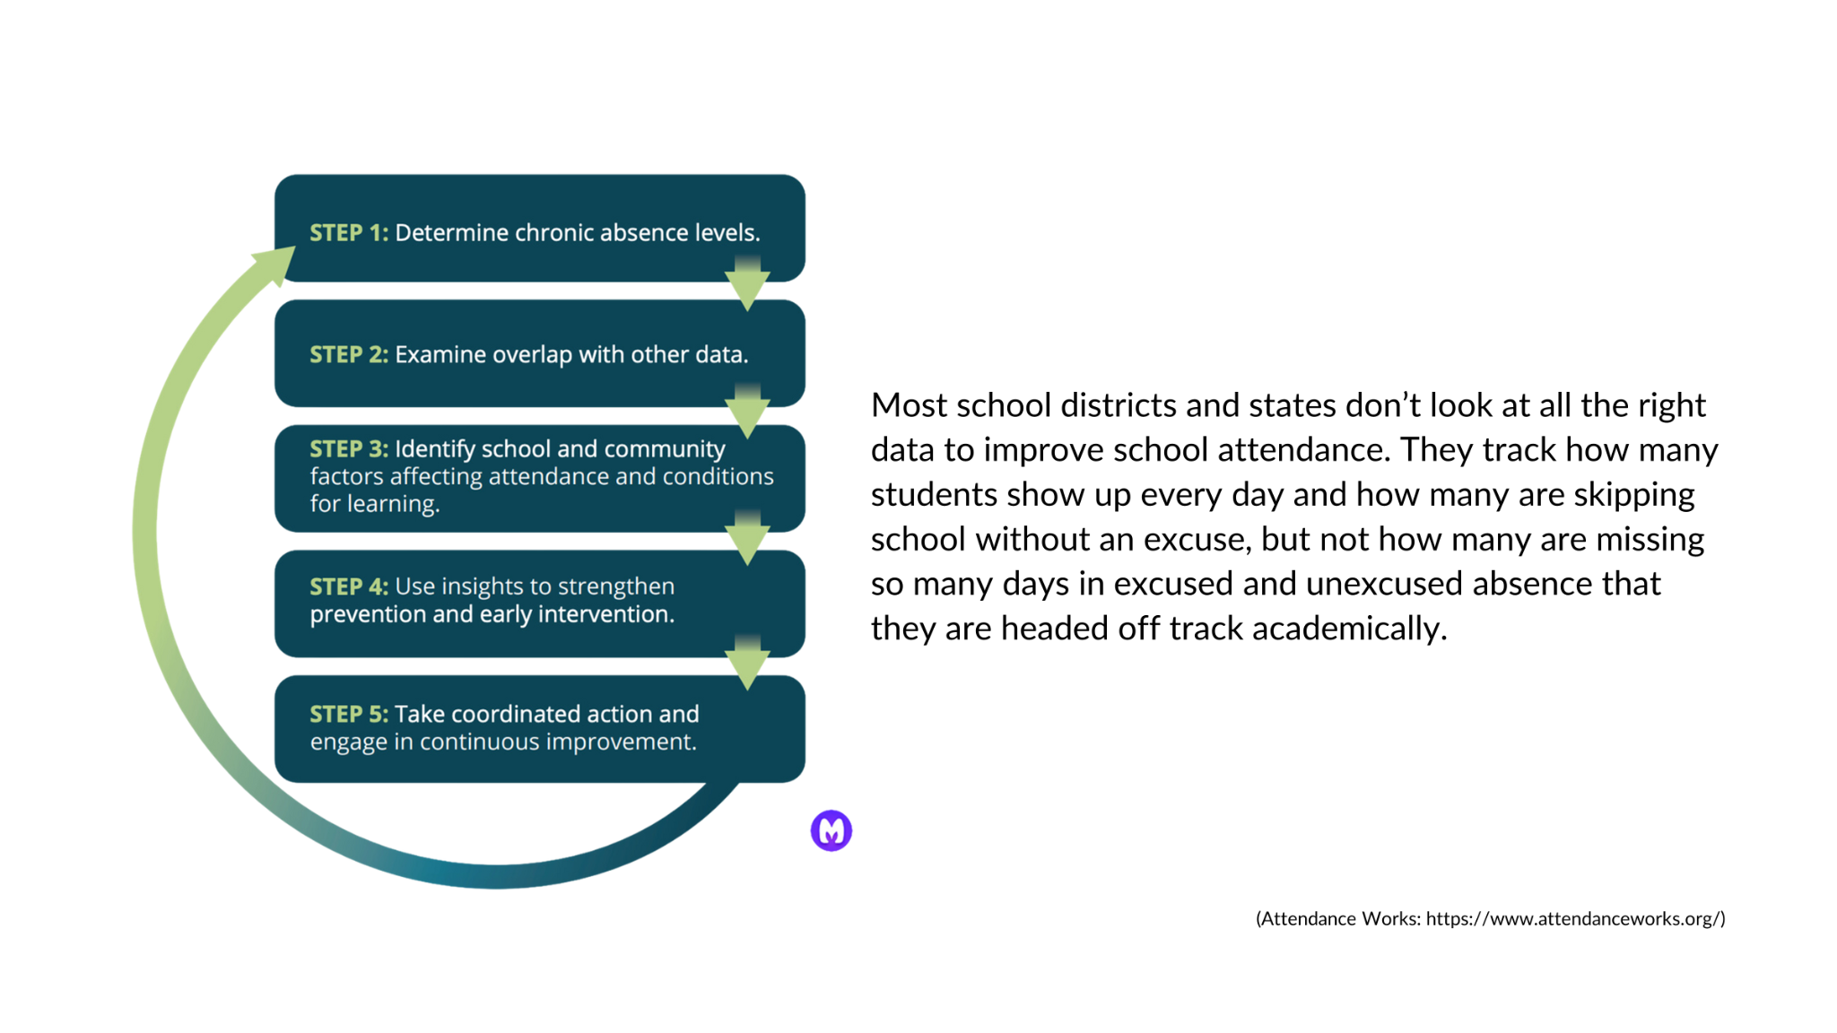

Slide 23
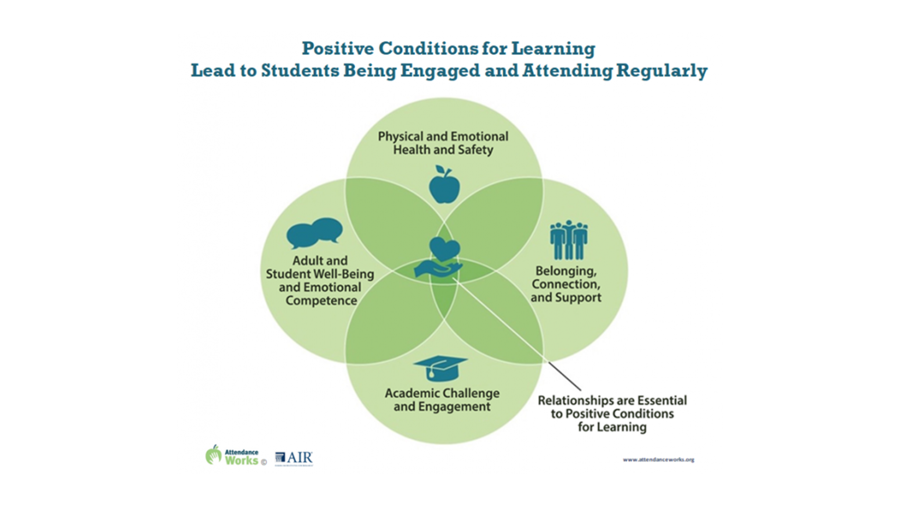

Slide 24
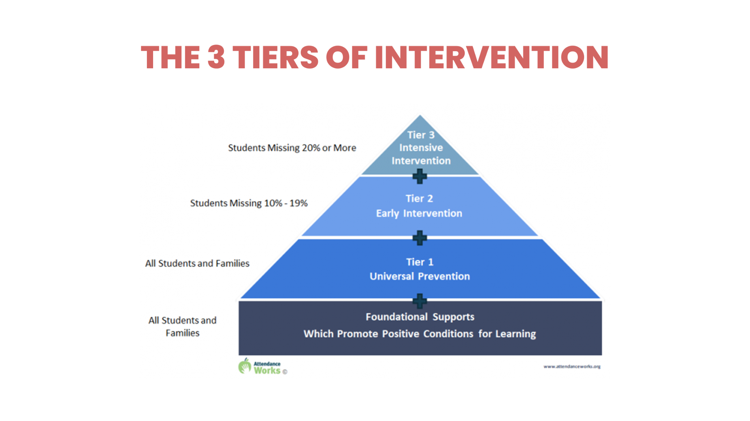

Slide 25
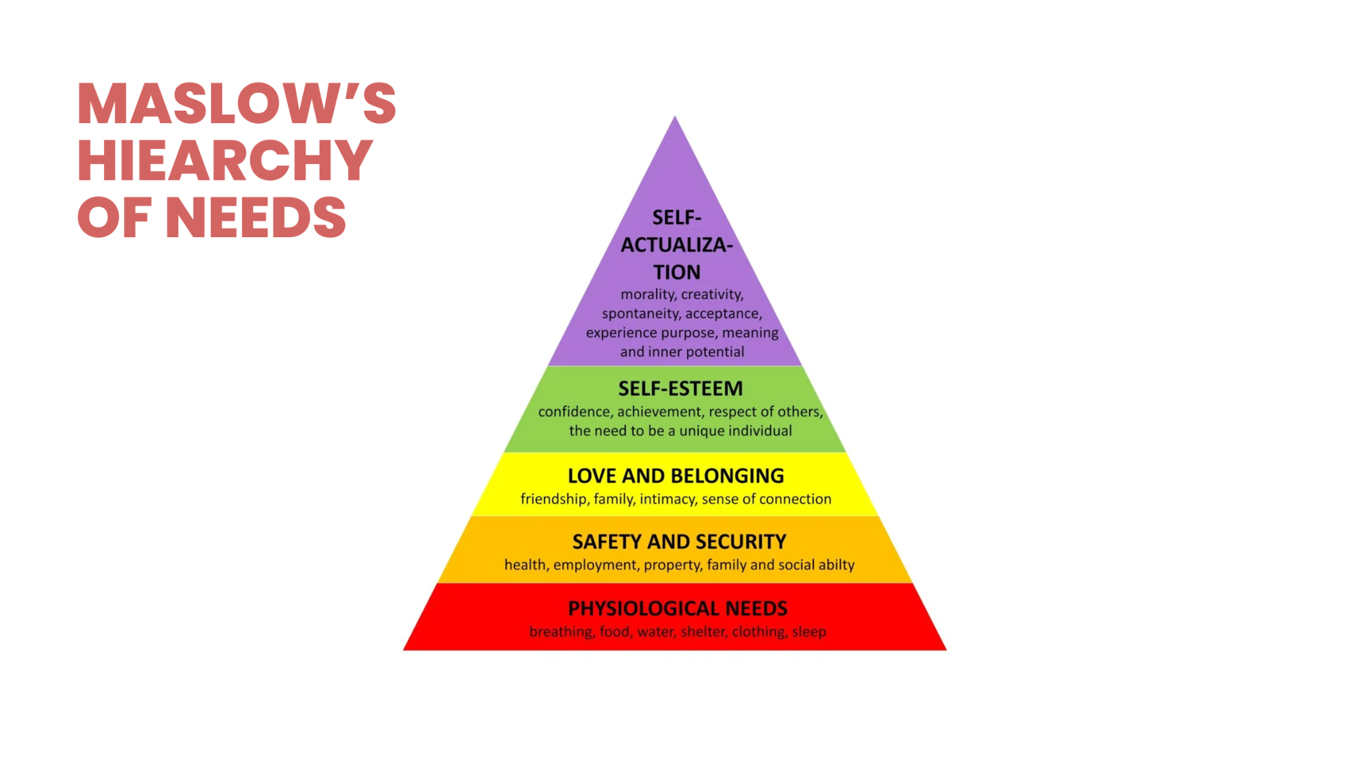

Slide 26
Notes:
Thank you for attending! If you would like to learn more about the pricing of SchoolSims, please email jjaramillo@schoolsims.com or click here: https://content.schoolsims.com/request-pricing.
We look forward to connecting with you soon!

Slide 27


